Slide 1
A Falls Asleep
Written for A by Mommy and Daddy

Slide 2
Hi! My name is A and this is my story about how I learn to fall asleep more easily.

Slide 3
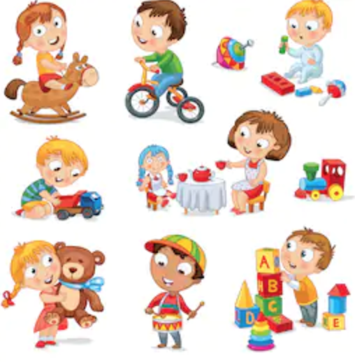
Sometimes when Mommy and Daddy put me into bed at night I have a feeling in my body like I want to get up and play with toys. I’m very creative and I can think of lots of fun things to do.

Slide 4
But sometimes when I stay up at night and play with my toys, I feel grumpy or have lots of big feelings the next day because I didn’t get enough sleep.

Slide 5
But now Mommy and Daddy are going to teach me to try something new.
At night when I lie down to go to bed I’m going to let my body relax.

Slide 6
I can start by relaxing my hands.
I can pretend I have a lemon in each of my hands. I can squeeze the lemons in my hands while I count to 10 slowly. I get all of the lemon juice out. Then I let the lemons go.
I can feel how calm and relaxed my hands and arms feel now.

Slide 7
Now I can relax my arms and shoulders. I can pretend I am a furry, lazy cat. I can stretch my arms way out in front of me, over my head and down by my sides. I hold my arms stiff like uncooked spaghetti. I can stretch my arms in all directions while I count to 10 slowly. Then I let my arms go quickly and they feel like cooked spaghetti.
I can feel how calm and relaxed my arms and shoulders feel now.
It feels good and warm and cuddly to be relaxed.

Slide 8
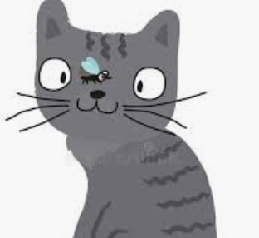
Here comes a pesky fly that landed on my nose. I can try to get him off without using my hands by wrinkling up my nose. I scrunch up my nose really hard while I count to 10 slowly.
Good I chased him away. Now I can relax my nose. Uh oh! That pesky fly is back and this time it landed on my forehead. I can wrinkle up my forehead. I scrunch up my forehead really hard while I count to 10 slowly.
Good I chased him away. Now I can relax my forehead. I can feel how calm and relaxed my whole face feels now.
My face feels smooth now with no wrinkles.

Slide 9
Hey! Here comes a cute baby elephant. But he’s not watching where he’s going. He doesn’t see me lying in the grass and he’s about to step on my tummy.
Get ready for him! I make my tummy really hard by tightening the muscles in my tummy as much as I can. I Hold it while I count to 10 slowly. Phew - It looks like he’s going the other way! Now I can relax my belly. I let my tummy be soft and feel as relaxed as I can. I can feel how calm and relaxed my whole belly feels now.
It feels good to relax.

Slide 10
Now I pretend I’m standing barefoot in a big fat mud puddle. I squish my toes deep into the mud, I use my legs to push my feet into the mud. I spread my toes as much as I can and then feel the mud squish between my toes.
I count to 10 slowly as I squish the mud in my toes.
Now I let go of the mud and relax. I relax my feet, toes and legs. It feels so good to relax. I feel warm and tingly.

Slide 11
I feel relaxed in my whole body now. All of the muscles in my body are like limp cooked spaghetti. I can let my eyes and my mind relax too.
Thoughts and ideas may come into my head.
I put those thoughts on a cloud and I watch them float in the sky. I can pay attention to those thoughts another time. I watch the clouds float in the sky. It feels like my body and mind are so relaxed I can float too.

Slide 12
THE END

